Slide 1
Optimizing User, Group, And Role Management With Access Control And Workflows
SlideMake.com

Slide 2
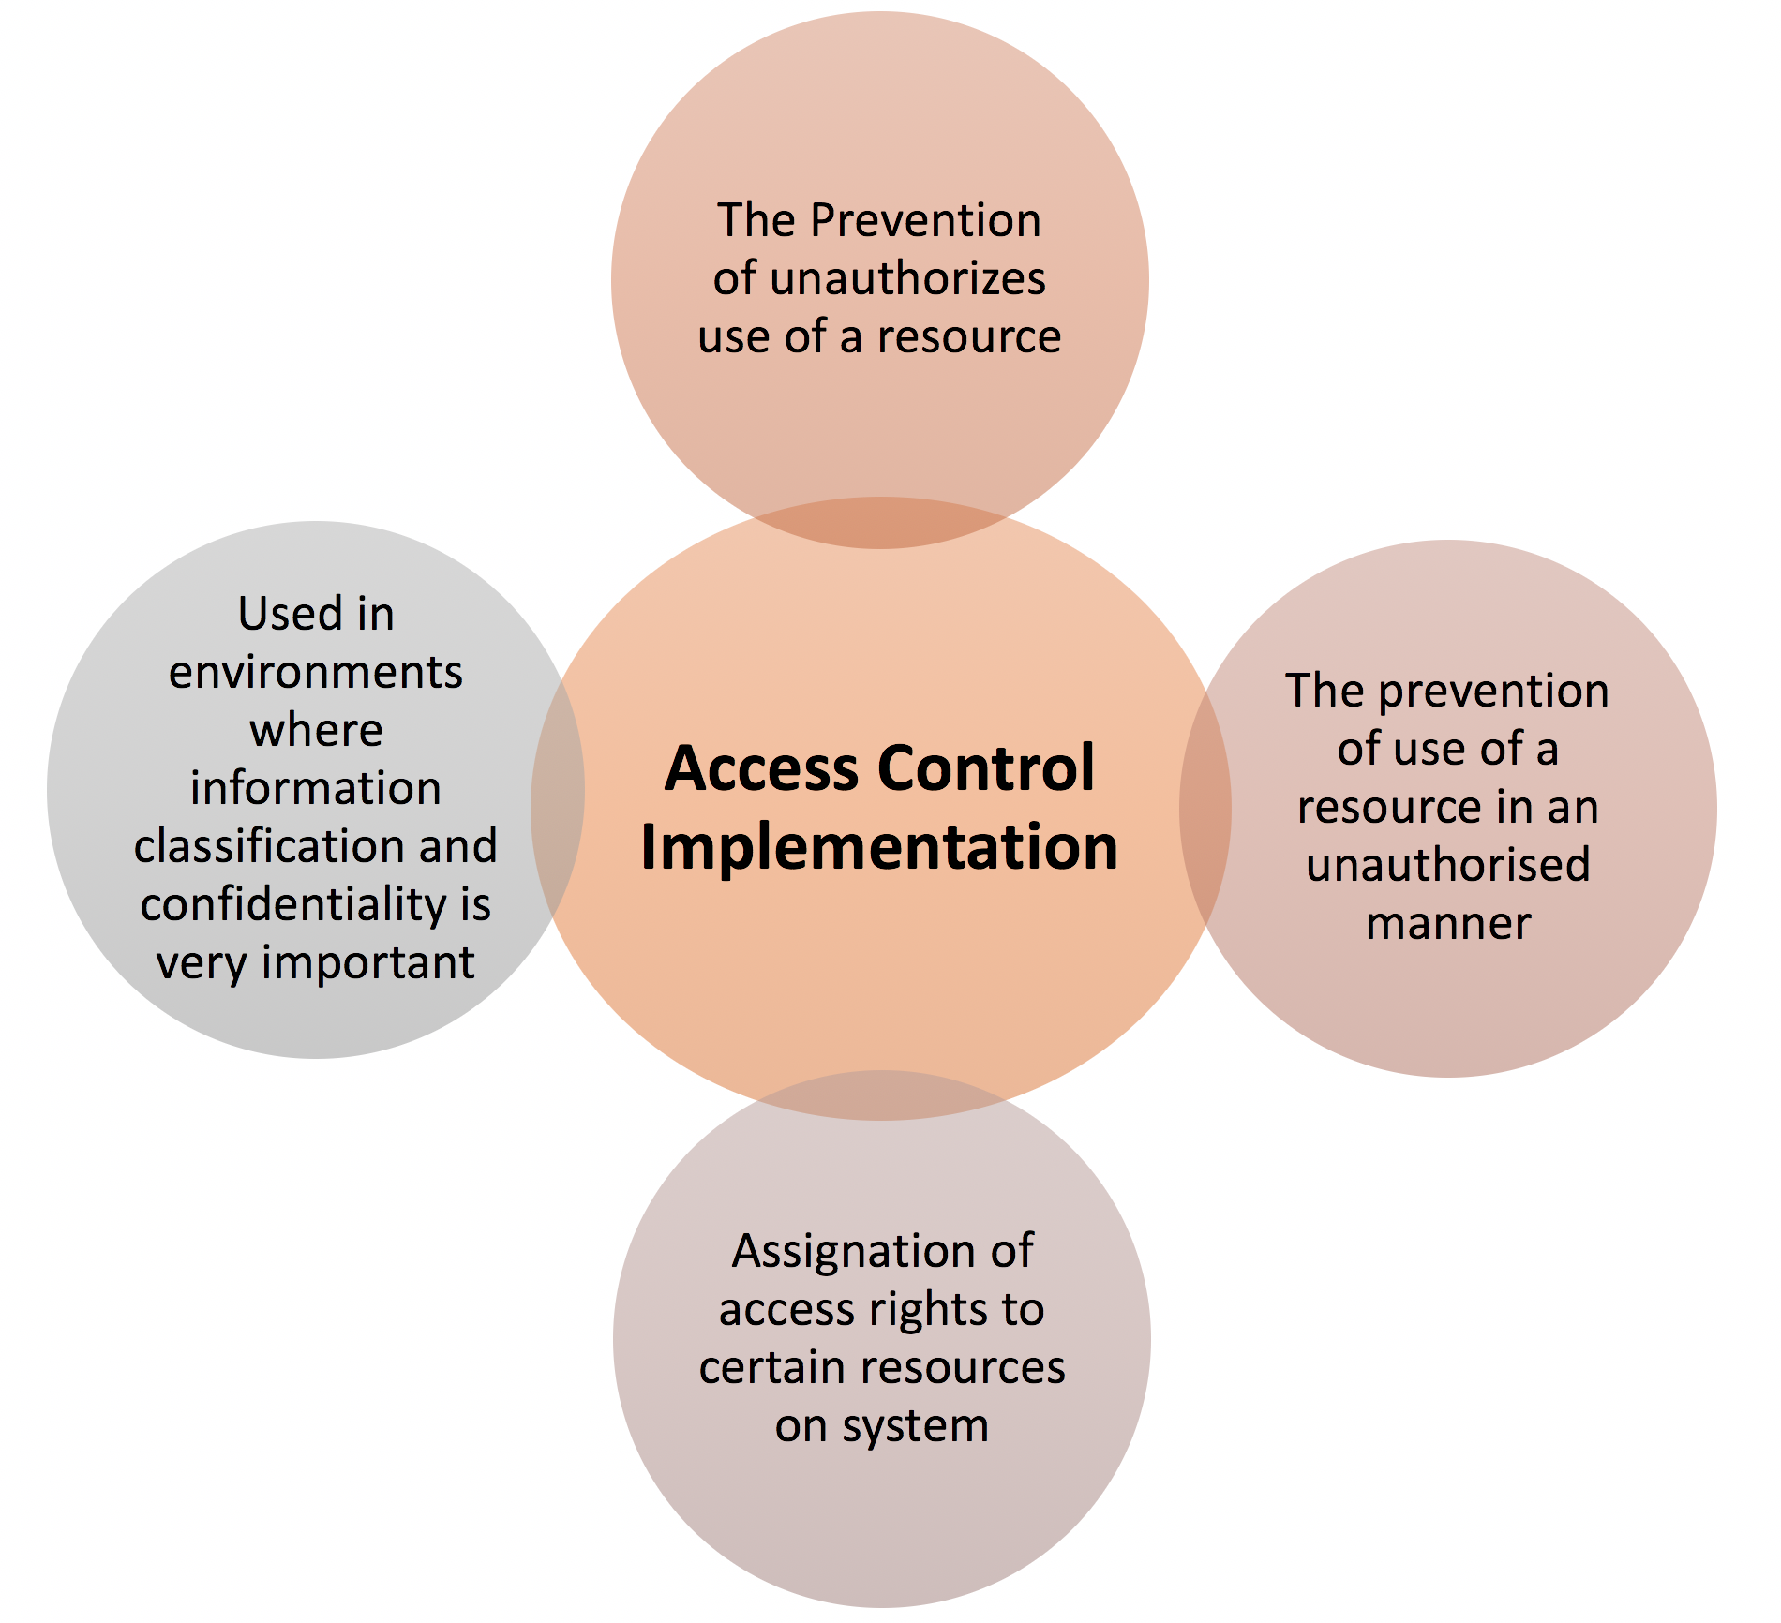
Introduction to User, Group, and Role Management
Effective management of users, groups, and roles is essential for secure access control.
Proper structuring simplifies permission assignment and enhances security posture.
This presentation explores strategies to optimize these management practices with workflows and access control mechanisms.
Notes:
Image source: https://www.xorlogics.com

Slide 3
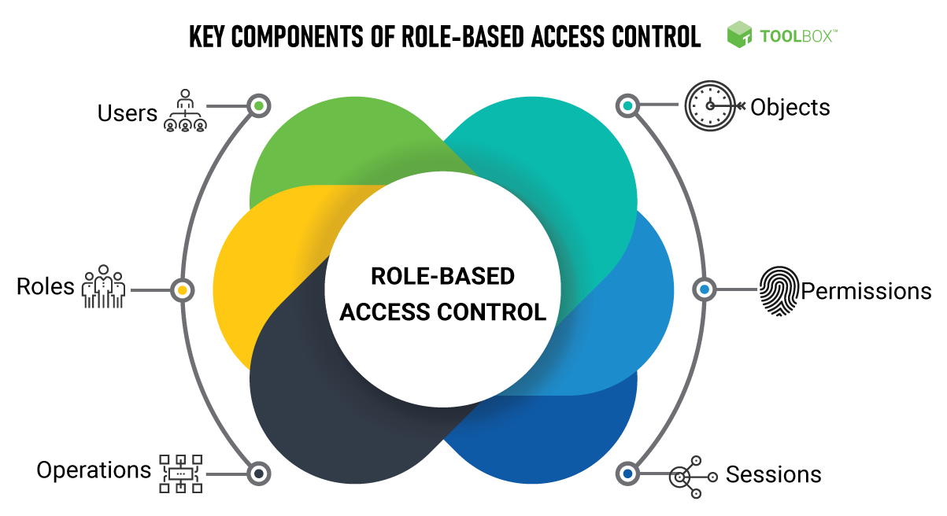
Importance of Access Control in Modern Organizations
Access control ensures that only authorized users can access specific resources.
It mitigates risks associated with data breaches and unauthorized activities.
Implementing robust access control frameworks improves compliance with regulatory standards.
Notes:
Image source: https://zd-brightspot.s3.us-east-1.amazonaws.com

Slide 4
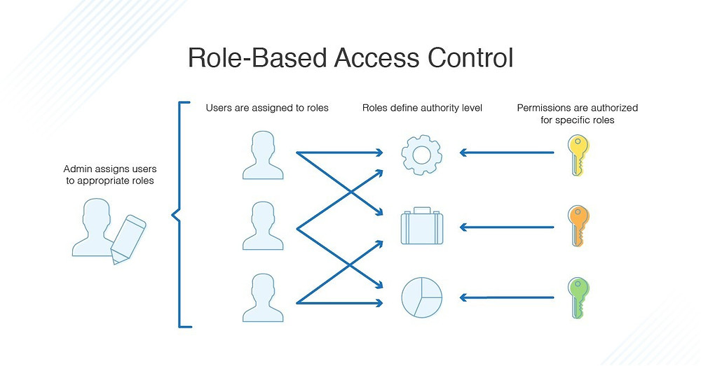
Key Concepts in User and Role Management
Users are individual identities assigned to perform tasks within an organization.
Groups aggregate users with similar permissions to streamline management.
Roles define a set of permissions associated with a particular job function or responsibility.
Notes:
Image source: https://static.wixstatic.com

Slide 5
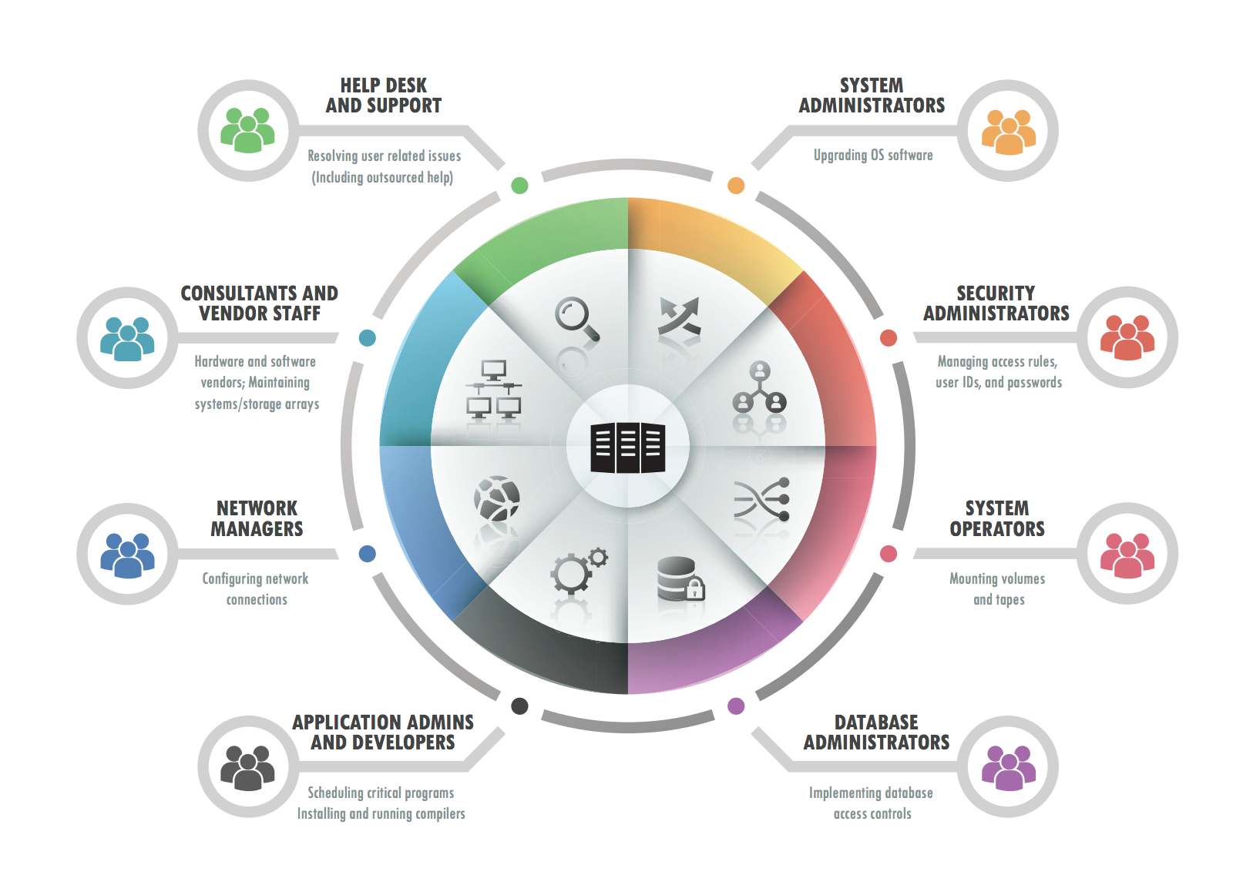
Best Practices for Managing Users and Groups
Regularly review and update user access rights to reflect current job roles.
Use descriptive naming conventions for groups to facilitate easy identification.
Automate onboarding and offboarding processes to ensure timely permission adjustments.
Notes:
Image source: https://www.coresecurity.com

Slide 6
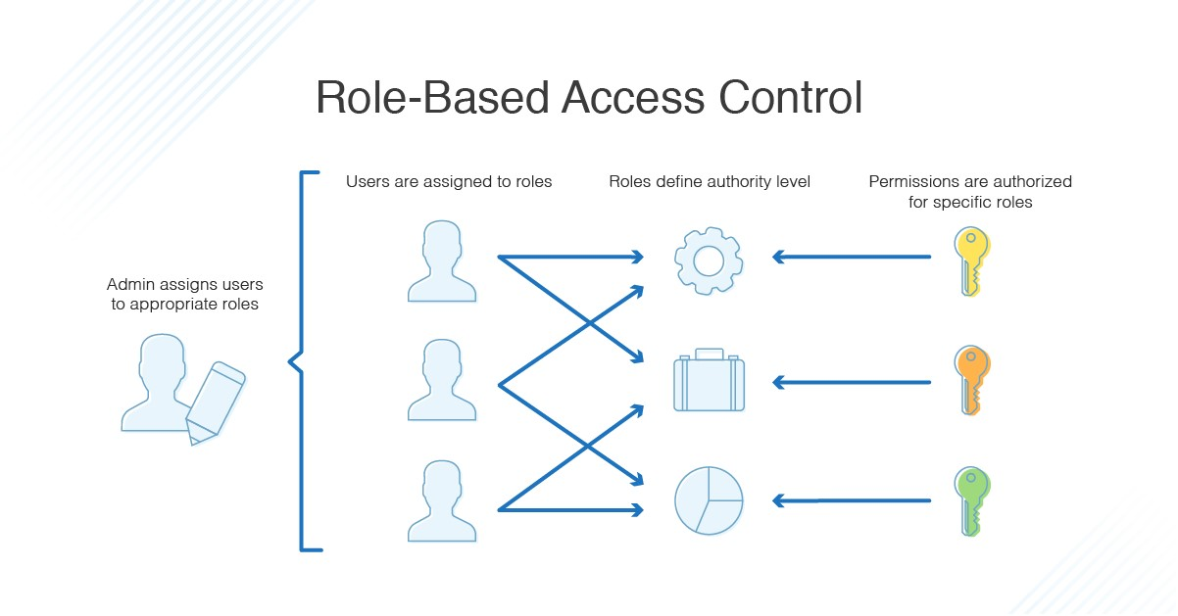
Role-Based Access Control (RBAC) Fundamentals
RBAC assigns permissions based on roles rather than individual users, simplifying management.
It enforces the principle of least privilege, granting only necessary access.
Defining clear roles helps in maintaining consistency and security across the organization.
Notes:
Image source: https://treewebsolutions.com

Slide 7
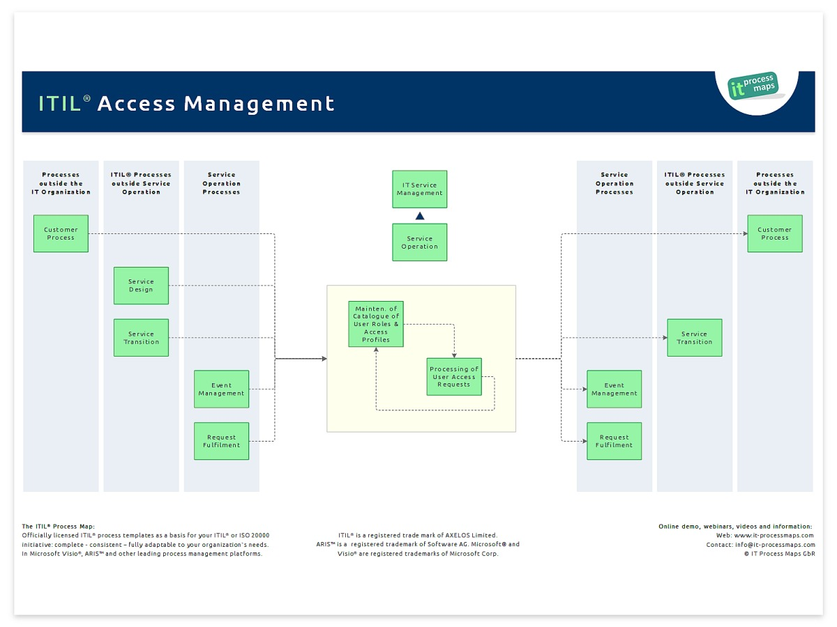
Implementing Workflows for User and Role Management
Workflows automate approval processes for user provisioning and permission changes.
They ensure consistent application of policies and reduce manual errors.
Workflow tools facilitate audit trails, supporting compliance and accountability.
Notes:
Image source: https://wiki.en.it-processmaps.com

Slide 8
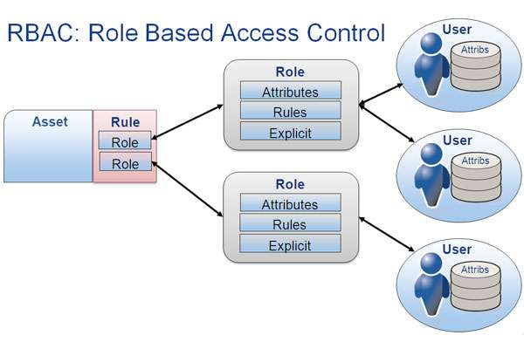
Enhancing Security with Access Control Policies
Use granular access policies to restrict resource access based on context and attributes.
Incorporate multi-factor authentication to strengthen user verification.
Regularly audit and refine access policies to adapt to evolving security threats.
Notes:
Image source: https://idenhaus.com

Slide 9
Integrating Automated Workflows and Access Control Systems
Integrate identity management systems with workflow automation tools for seamless operations.
Automate role assignments based on predefined criteria, such as department or project.
Use alerts and notifications within workflows to monitor and respond to access anomalies.
Notes:
Image source: https://zd-brightspot.s3.us-east-1.amazonaws.com

Slide 10
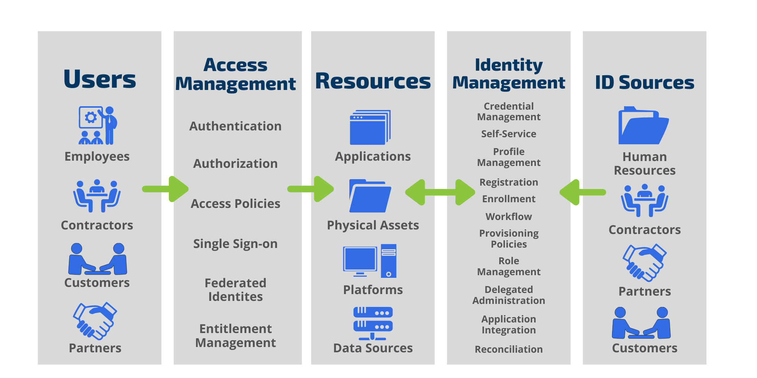
Benefits of Optimized User, Group, and Role Management
Improved security through controlled and auditable access permissions.
Increased operational efficiency by reducing manual management efforts.
Enhanced compliance with regulatory standards and internal policies.
Notes:
Image source: https://braxtongrant.com

Slide 11
Conclusion and Key Takeaways
Effective management of users, groups, and roles is vital for organizational security.
Utilizing workflows and access control policies streamlines administration and reduces risks.
Continuous review and automation are essential for maintaining an optimized access management system.
Notes:
Image source: https://idenhaus.com

